Slide 1
The Silver screen
Luis Garcia, Audrey Lamb, Choi wa tsang, Laytoamb Wiggins

Slide 2

The silver screen
What makes a good movie?
Why are movies always in demand?
What determines the success of a movie?

Slide 3
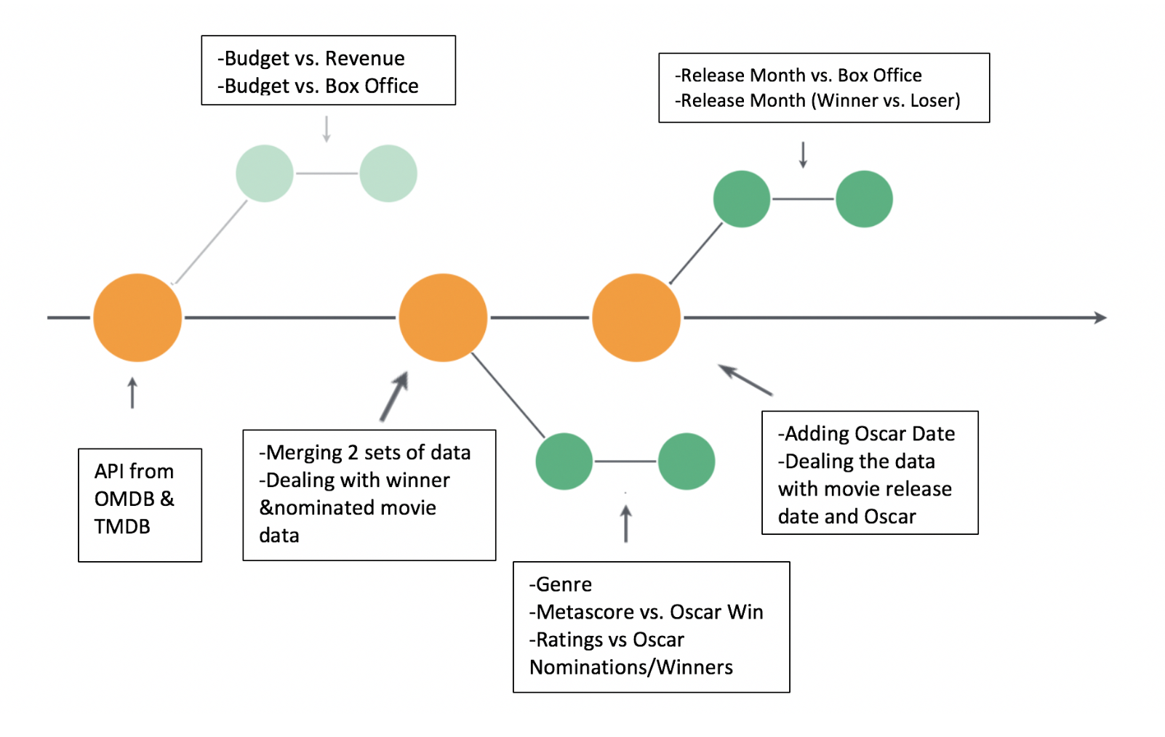
The silver screen
Datasets that were used were Kaggle, OMDB and TMDB
2005-2105

Slide 4
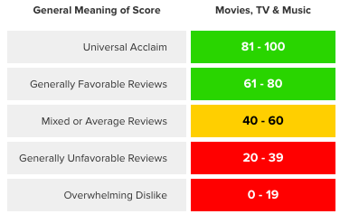
The silver screen
Metascore uses a weighted average of the world’s most respected critics.. A score of 81 or above designates the movie as a “Must See”. In the Metacritic’s database only 5% of movies achieve this score.

Slide 5
The silver screen
Picking the Oscar Winners
To be eligible for nominations in any of the feature film categories, a movie must meet these basic requirements [source: 90TH Annual Academy Awards of Merit Rules]:
It must be more than 40 minutes long.
Its public premiere must have been in a movie theater, during the appropriate calendar year.
It must have premiered in 35mm or 70mm film format or in 24-frame, progressive scan digital format.
It must have played in an L.A. County theater, for paid admission, for seven consecutive days, beginning in the appropriate calendar year.

Slide 6
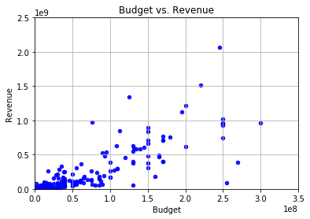
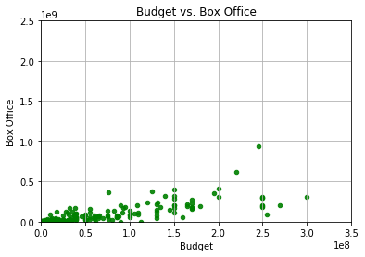
The silver screen

Slide 7
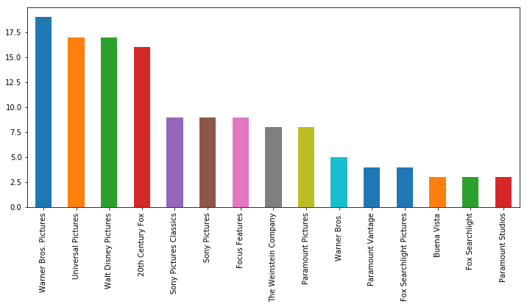
The silver screen
Top 15 Production Companies who have won Oscars

Slide 8
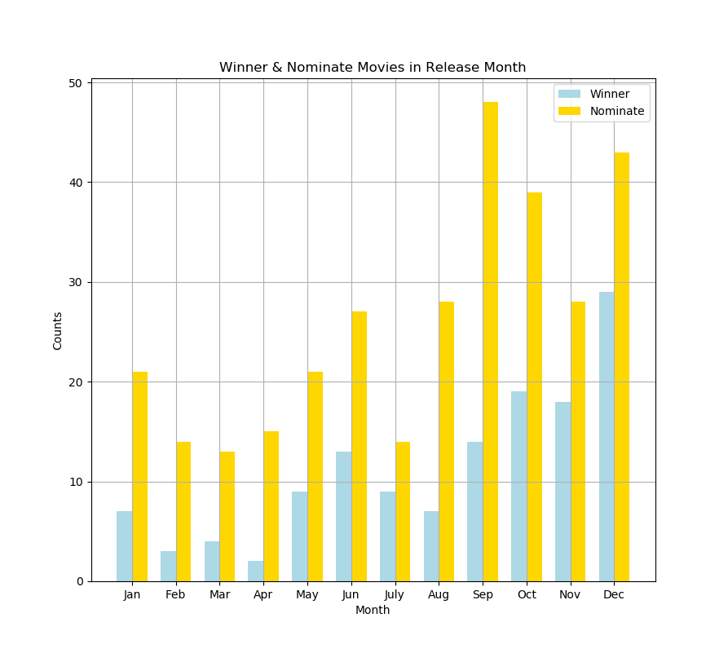
The silver screen
Release Month (Winner vs. Nominate)

Slide 9
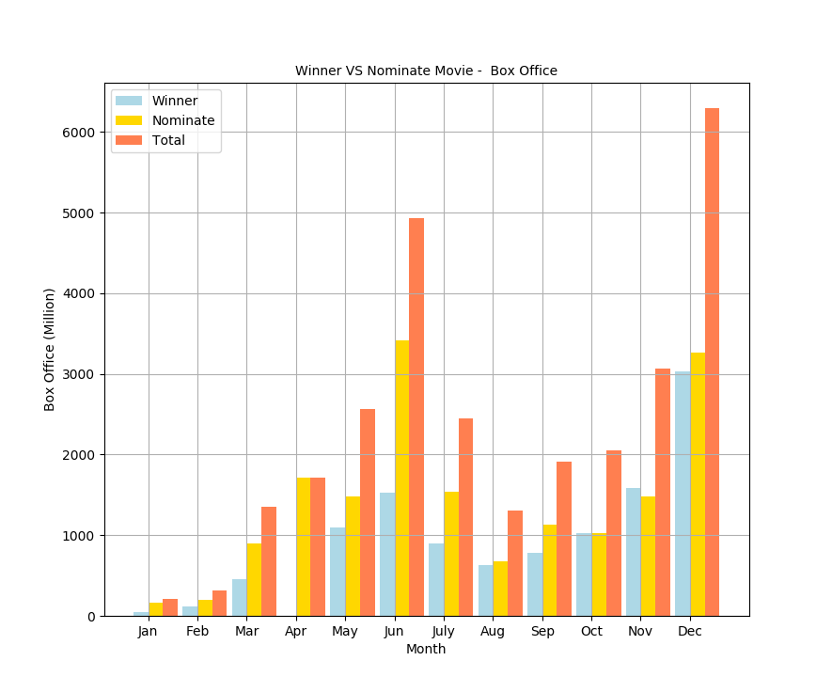
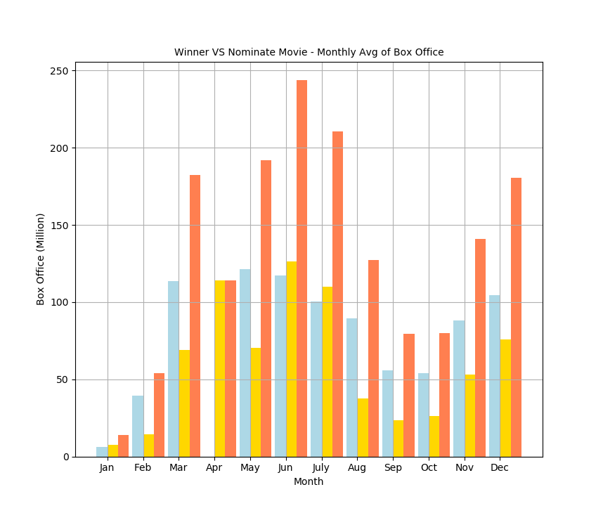
The silver screen

Slide 10
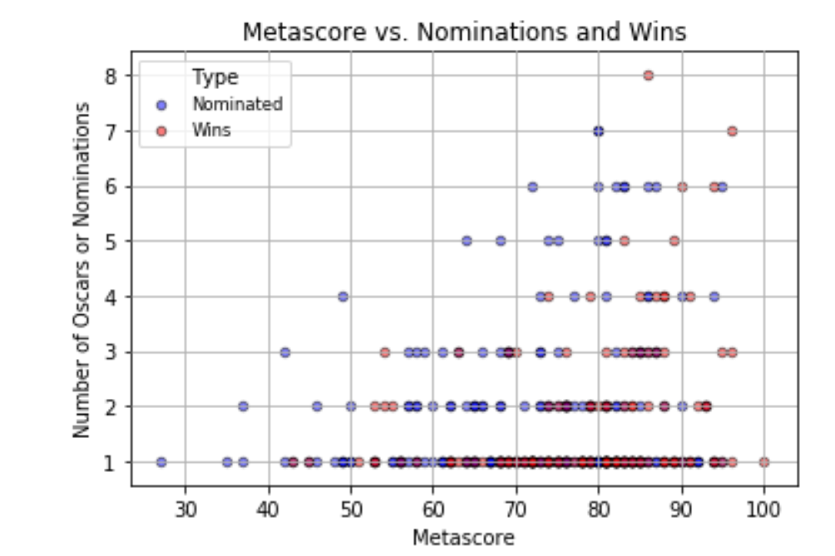
The silver screen
Metascore

Slide 11
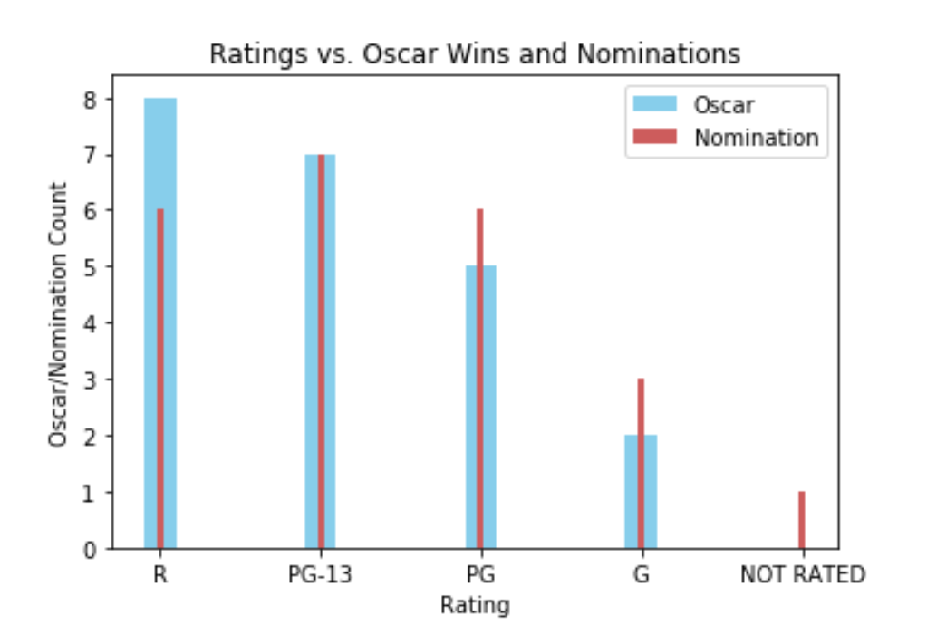
The silver screen
Ratings

Slide 12
The silver screen
PG-13 rated movies received the most Academy nominations, while R rated movies won the most Academy awards
December is the best month to release films to audiences, as December achieved the highest box office dollars
Warner Bros. is the best production company to produce award winning films
High Metascore ratings have the best potential outcome of winning awards

Slide 13
The silver screen
ENDING CREDITS
Questions??

